Slide 1

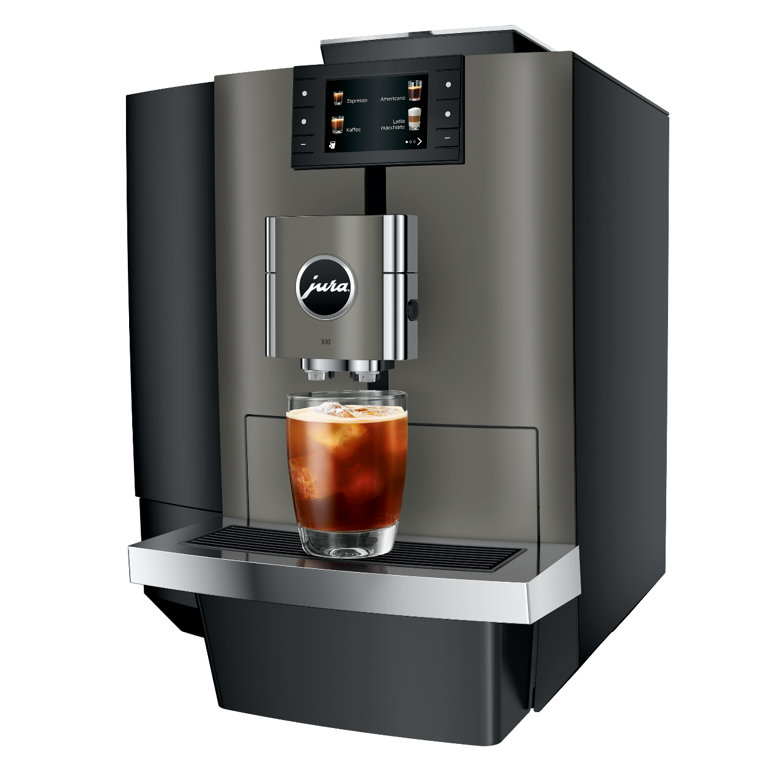
X10 (SA/EA)
David Morand / 03.10.2023

Slide 2
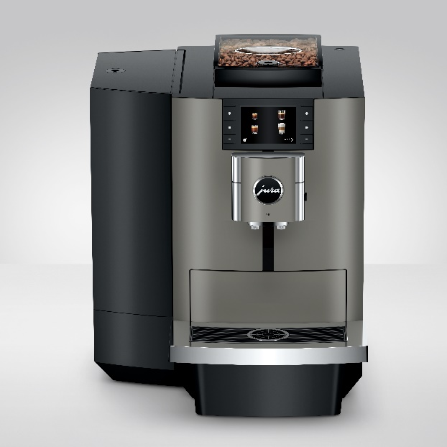
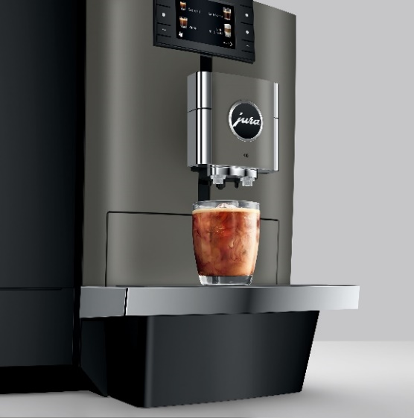

Designations
General
Article Description: X10
Name: | Article no.: | EAN-Code:
X10 Dark Inox (SA) | 15545 | 7610917155453
X10 Dark Inox (EA) | 15546 | 7610917155460
Availability
Additional Information
November 2023
Replaces the current X8
Information
The professional machine for hot and cold speciality coffees – versatile, robust and reliable.
Speciality coffees from a pro
The X10 sets new standards, bringing variety and freshness. Quite literally, because its repertoire includes an impressive 36 speciality coffees, nine of which are cold extracted. The fully automatic cold extraction process is a special feature of the X10 and brings refreshing Cold Brews to the professional sector. The X10's versatility also extends to longer specialities using more water, such as americanos and lunghi. Thanks to the One Touch Lungo function, it also prepares these specialities at the touch of a button. In addition to the wide variety of beverages, the P.A.G.2+ grinder and functions of the professional automatic machine are also impressive. The X10 is easy to operate thanks to the colour display and physical buttons, making it appropriately accessible. The X10 is the ideal size for use in offices, self-service areas or catering businesses with a daily demand of 80 preparations.
Cold Brews at the touch of a button
The X10 brings refreshing coffee enjoyment to offices and self-service areas with a selection of Cold Brews. Freshly ground at the touch of a button, not encapsulated and cold extracted. This is made possible by the Cold Extraction Process developed by JURA. In this extraction process, cold water passes through the freshly ground coffee, pulsating under high pressure and with a slow cycle frequency. The fruity aromas are thus optimally absorbed by the water and result in a natural and energising cold beverage.

Slide 3
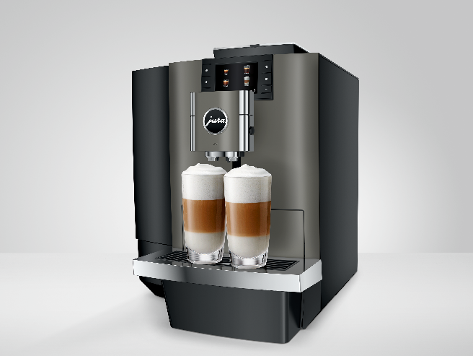
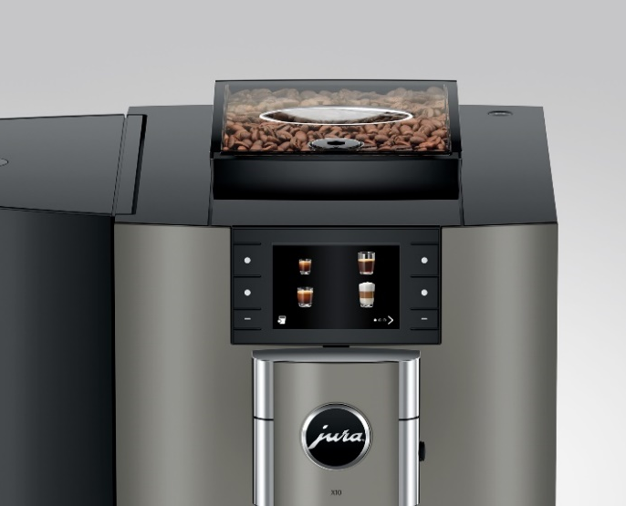
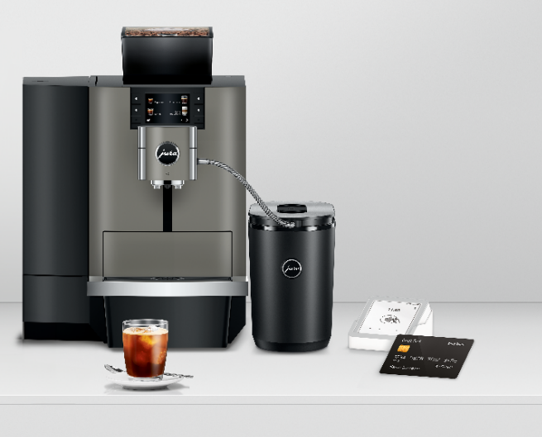
A variety of specialities to suit every taste
Diversity is on the agenda for the X10. Designed to offer the ultimate indulgence, the professional fully automatic machine impresses with 36 speciality coffees. The repertoire ranges from coffee classics, such as espresso and cappuccino, to double speciality coffees with milk, such as latte macchiato, and trendy Cold Brews. As usual at the touch of a button, and now flowing into the cup via the central dual spout. The X10 redefines the coffee experience in open-plan offices and self-service areas in unprecedented dimensions.
Robust and refined
Form follows function – that is the maxim of the X10, which is characterised by clean lines and direct user guidance. The height-adjustable spout combines hot water, milk and coffee spouts and ensures easy operation. The newly designed front in Dark Inox emphasises the professionalism and timeless elegance of the automatic coffee machine. Furthermore, the X10 impresses with its convenient and intuitive operating concept via the 3.5-inch display. Integrated into the front and complemented by physical buttons, the display emphasises the clarity of the professional fully automatic machine.
Modern payment methods supported
The X10 can be optionally supplemented with the MDB interface unit from JURA. As a result, it supports the most common payment systems and offers maximum flexibility and simplicity. Be it for credit cards, batch or mobile payment systems, the choice is open. JURA Pocket Pilot is also available. In addition to contactless payment, the free software from JURA impresses with a billing and management system.

Slide 4
Benefits
Cold brews taste fresh and fruity. With the X10, you can enjoy cold-extracted coffee specialties at the touch of a button.
Espresso, latte macchiato and cold brew - coffee enjoyment is versatile. The X10 redefines the coffee experience in offices and self-service areas in unprecedented dimensions.
Form follows function: the height-adjustable spout combines hot water, milk and coffee dispensing and offers clear operation.
Payment made easy: With the X10, you have a choice of the most popular payment systems, whether credit card, batch or mobile.
36 Specialties
 | 1 x | 2 x | Cold Brew | Extra Shot
Espresso | ✓ | ✓ | ✓
Coffee | ✓ | ✓ | ✓
Americano | ✓ | ✓ | ✓
Lungo | ✓ | ✓ | ✓
Cappuccino | ✓ | ✓ | ✓ | ✓
Latte macchiato | ✓ | ✓ | ✓ | ✓
Flat White | ✓ | ✓ | ✓ | ✓
Cortado | ✓ | ✓ | ✓
Cafè Latte | ✓ | ✓ | ✓ | ✓
Portion of milk | ✓ | ✓
portion of milk foam | ✓ | ✓
Hot water | ✓

Slide 5
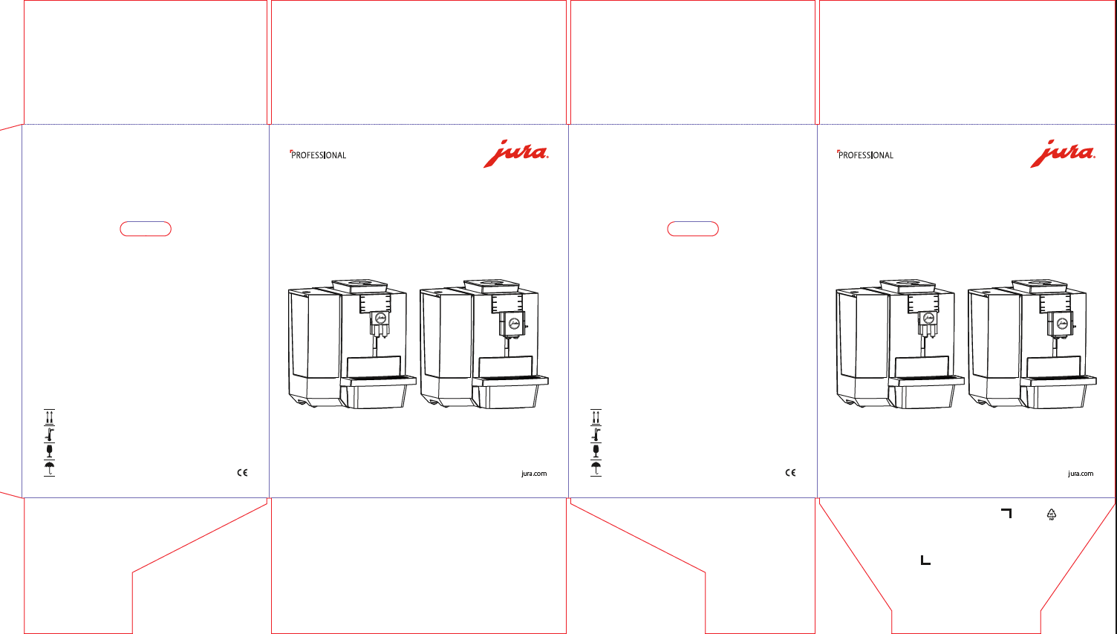
Packing
Scope of delivery
Picture carton:
Gross weight: 17.1 kg
Net weight: 13.46 kg
Dimensions Carton: 52.5 x 43.5 x 59.5cm
Cartons/Pal: 12
CLARIS Pro Smart+
Aquadur hardness sticks
Key for Bean Container / Water Tank
Milk set
Milk system cleaning container
Milk system cleaner Mini-Tabs
3-phase cleaning tablets
Operating instructions
Guarantee conditions leaflet
Envelope Machine passport
Combi start-up card
Address label
Launch measures
Fairs and Events
Product Film
Online Academy
Product sheet
Product overview 2023
Sales Presentation
Product images and product film

